Slide 1


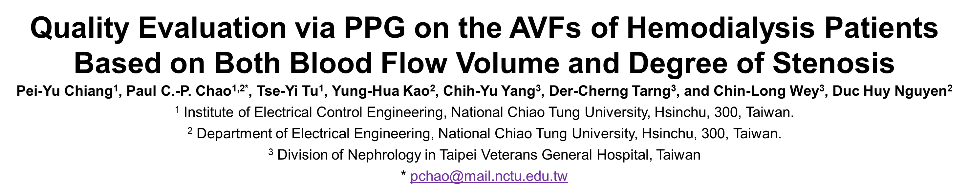
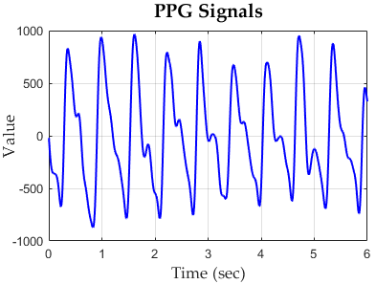
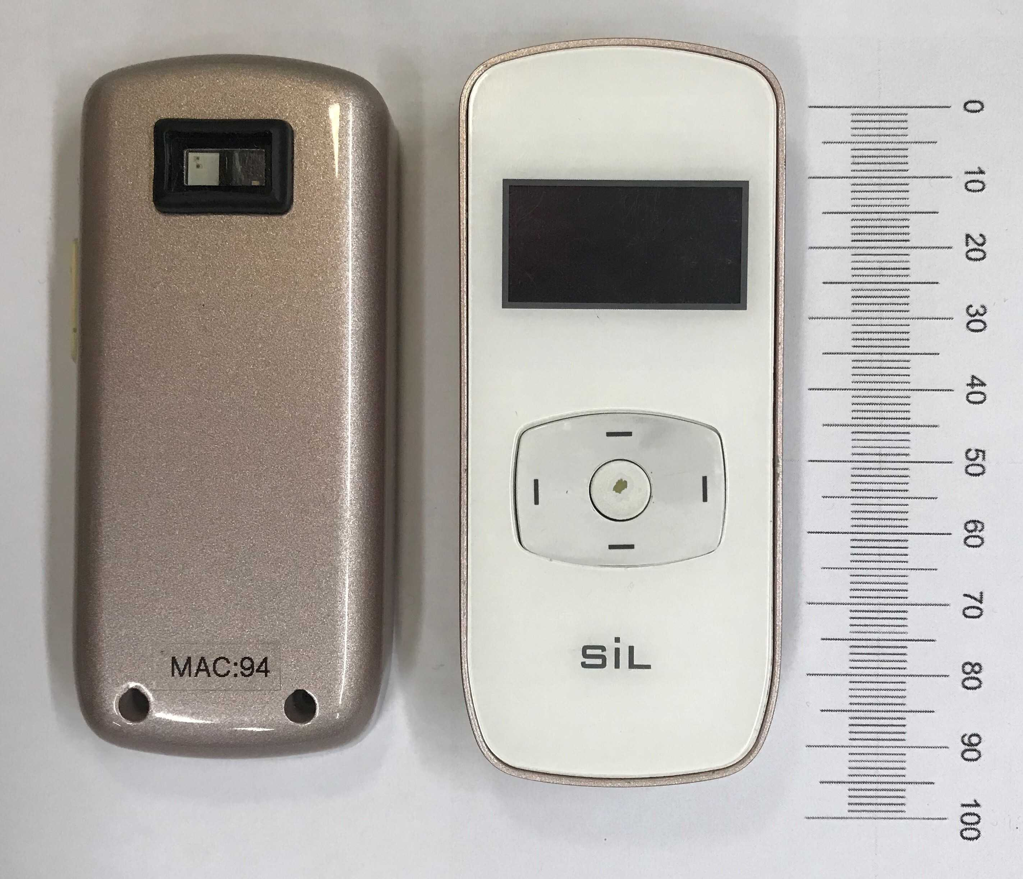
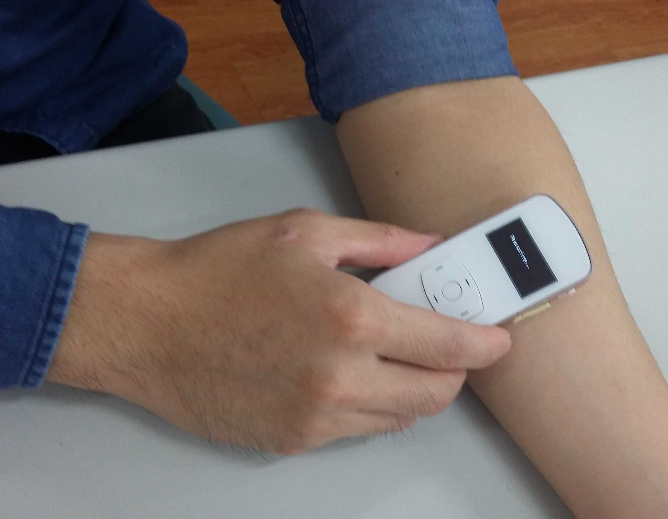
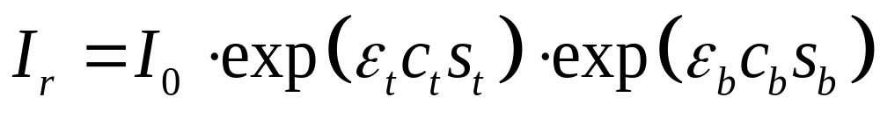
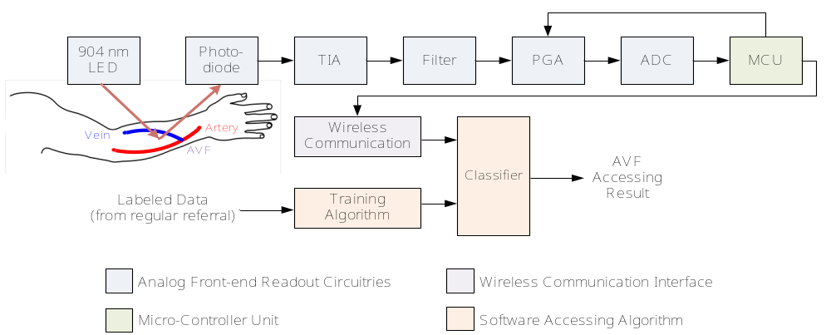
1. BACKGROUND AND MOTIVATION
2. THEORY AND PRINCIPLE
2. THEORY AND PRINCIPLE
Support vector machine (SVM) learning for assessing quality of arteriovenous fistula (AVF) at hemodialysis patients using a new photoplethysmography (PPG) sensor for providing
Monitoring Blood Flow at home.
Inexpensive, small-sized and easy-to-use solution needed.
Photoplethysmography (PPG) sensor
Non-invasive method aiming at sensing the pulsation of Blood Vessel.
Evaluating the reflective lights from LED and PD.
The mathematical equation of a PPG signal using Beer Lambert’s law, as
Photoplethysmography (PPG) sensor
Non-invasive method aiming at sensing the pulsation of Blood Vessel .
Evaluating the reflective lights from LED and PD.
The mathematical equation of a PPG signal using Beer Lambert’s law, as
A typical experimental PPG waveform measured by the proposed BF sensor.
The photo of the proposed PPG sensor for assessing AVF quality
3. SYSTEM DESIGN
4. CLINICAL VALIDATION & EXPERIMENT RESULTS
A. Readout Circuitries
The readout architecture of the proposed PPG sensor systems consist
Front-end analog readout circuitries.
Micro-controller unit (MCU).
Wireless communication unit.
Accessing algorithm.
The patients are evaluated healthy when both
DOS smaller than 30% .
BFV larger than 600 ml/min.
A typical experimental PPG waveform measured by the proposed BF sensor.
Samples Number = 74 |  | Ground Truth (Actual Class)
 |  | Positive | Negative
Classification Results of kNN (Predicted Class) | Positive | TP = 27 (36.49%) | FP = 8 (10.81%)
 | Negative | FN = 7 (9.46%) | TN = 32 (43.24%)
Classification Results of NBC (Predicted Class) | Positive | TP = 24 (32.43%) | FP = 3 (4.05%)
 | Negative | FN = 10 (13.51%) | TN = 37 (50.00%)
Classification Results of SVM (Predicted Class) | Positive | TP = 30 (40.54%) | FP = 5 (6.76%)
 | Negative | FN = 4 (5.41%) | TN = 35 (47.30%)
3. SYSTEM DESIGN
4. CLINICAL VALIDATION & EXPERIMENT RESULTS
A. Readout Circuitries
The readout architecture of the proposed PPG sensor systems consist
Front-end analog readout circuitries.
Micro-controller unit (MCU).
Wireless communication unit.
Accessing algorithm.
The patients are evaluated healthy when both
DOS smaller than 30% .
BFV larger than 600 ml/min.
Samples Number = 74 |  | Ground Truth (Actual Class)
 |  | Positive | Negative
Classification Results of kNN (Predicted Class) | Positive | TP = 27 (36.49%) | FP = 8 (10.81%)
 | Negative | FN = 7 (9.46%) | TN = 32 (43.24%)
Classification Results of NBC (Predicted Class) | Positive | TP = 24 (32.43%) | FP = 3 (4.05%)
 | Negative | FN = 10 (13.51%) | TN = 37 (50.00%)
Classification Results of SVM (Predicted Class) | Positive | TP = 30 (40.54%) | FP = 5 (6.76%)
 | Negative | FN = 4 (5.41%) | TN = 35 (47.30%)
5. CONCLUSION
B. Input feature
The optical theory of PPG is solved by analogy the telegrapher equation to determine the input features of classifiers.
The experimental results successfully achieve 87.838% accuracy in assessing AVF.
The PPG sensor and the SVM algorithm show a more favorable solution in terms of sensor number, size and performance integrally
SYMBOL | FEATURES FOR DOS | Features for BFV | MEASUREMENT | DESCRIPTION
SBP,MAX | O | O | The proposed PPG sensors | The maximum length of light transmission path in blood
SB,MIN | O | O | The proposed PPG sensors | The minimum length of light transmission path in blood
SPO2 | O | O | Oximeter | The blood oxygen saturation level
SBP | O | O | Electronic sphygmomanometer | The systolic blood pressure
DBP | O | O | Electronic sphygmomanometer | The diastolic blood pressure
Ω | X | O | The proposed PPG sensors | The heart rate
 | Y.-C. Du et al. (2018) | D. F. Yeih et al. (2014) | J. X. Wu et al. (2015) | P. Y. Chiang et al. (2017) | This work
Sensor | Bilateral PPG | Stethoscope Auscultation | Ultrasound | Single PPG | Single PPG
Assessing Index | DOS | DOS | DOS | BFV | DOS & BFV
Principle | Optical | Acoustic | Doppler | Optical | Optical
Communication | Wired | Wireless | Wired | Wireless | Wireless
Assessing Algorithm | Neural Network | Support Vector Machine | Color Relation Analysis | Neural Network | Support Vector Machine
Size | Moderate | - | Bulky | 9 cm × 8 cm × 4 cm | 9 cm × 3.5 cm × 1.5 cm
Number of Subjects | 11 | 22 | 50 | 40 | 74
Accuracy | 94.82% | 84.3% | 83% | R² = 0.7176 | R² = 0.87838
Type II Error | - | 16.7% | - | > 50% | 11.765%
5. CONCLUSION
The optical theory of PPG is solved by analogy the telegrapher equation to determine the input features of classifiers.
The experimental results successfully achieve 87.838% accuracy in assessing AVF.
The PPG sensor and the SVM algorithm show a more favorable solution in terms of sensor number, size and performance integrally
B. Input feature
SYMBOL | FEATURES FOR DOS | Features for BFV | MEASUREMENT | DESCRIPTION
SBP,MAX | O | O | The proposed PPG sensors | The maximum length of light transmission path in blood
SB,MIN | O | O | The proposed PPG sensors | The minimum length of light transmission path in blood
SPO2 | O | O | Oximeter | The blood oxygen saturation level
SBP | O | O | Electronic sphygmomanometer | The systolic blood pressure
DBP | O | O | Electronic sphygmomanometer | The diastolic blood pressure
Ω | X | O | The proposed PPG sensors | The heart rate
 | Y.-C. Du et al. (2018) | D. F. Yeih et al. (2014) | J. X. Wu et al. (2015) | P. Y. Chiang et al. (2017) | This work
Sensor | Bilateral PPG | Stethoscope Auscultation | Ultrasound | Single PPG | Single PPG
Assessing Index | DOS | DOS | DOS | BFV | DOS & BFV
Principle | Optical | Acoustic | Doppler | Optical | Optical
Communication | Wired | Wireless | Wired | Wireless | Wireless
Assessing Algorithm | Neural Network | Support Vector Machine | Color Relation Analysis | Neural Network | Support Vector Machine
Size | Moderate | - | Bulky | 9 cm × 8 cm × 4 cm | 9 cm × 3.5 cm × 1.5 cm
Number of Subjects | 11 | 22 | 50 | 40 | 74
Accuracy | 94.82% | 84.3% | 83% | R² = 0.7176 | R² = 0.87838
Type II Error | - | 16.7% | - | > 50% | 11.765%

